Slide 1
Configuration Management

Slide 2
Background
For testing, configuration management may involve ensuring that:
All items of testware are identified, version controlled, tracked for changes, related to each other and related to development items (test objects) so that
All identified documents and software items are referenced unambiguously in test documentation
The configuration management procedures and infrastructure (tools) should be chosen, documented and implemented.

Slide 3
Req. Spec.
...
Des. Spec.
...
Code
...
Test Spec.
...
Config. Files
...
Build Env
Releases
User Docs
V1
V1
File 1
V1
File 1
V1
V1
V2
V2
V1
V2
V1
V2
V1.0
V2
V3
V3
V2
V3
V2
V3
V3
V4
V4
V3
V4
V3
V4
V4
Vn
Vn
V4
Vn
V4
Vn
Vn
Vn
Vn
V1.1
File 2
File 2
V2.0
V1
V1
V2
V2
V3
V3
V4
V4
Vn
Vn
V2.1
File N
File N
V1
V1
V2
V2
V3
V3
V4
V4
Vn
Vn

Slide 4
Req. Spec.
...
Des. Spec.
...
Code
...
Test Spec.
...
Config. Files
...
Build Env
Releases
User Docs
V1
V1
File 1
V1
File 1
V1
V1
V2
V2
V1
V2
V1
V2
V1.0
V2
V3
V3
V2
V3
V2
V3
V3
V4
V4
V3
V4
V3
V4
V4
Vn
Vn
V4
Vn
V4
Vn
Vn
Vn
Vn
V1.1
V1.1.1
File 2
File 2
V2.0
V1
V1
V2
V2
V3
V3
V4
V4
Vn
Vn
V2.1
File N
File N
V1
V1
V2
V2
V3
V3
V4
V4
Vn
Vn
Receive Support &
Maint Req.
Reproduce Build
(if necessary)
Reproduce Issue
Update Supporting
Artefacts
(if necessary)
Fix Issue
(if necessary)
Ship patch /
New build
(if necessary)
Don’t break earlier
functionality / quality

Slide 5

Symptoms of poor configuration management
Can't find latest version of source code or match source to object
Can't replicate previously released version of code for a customer
Bugs that were fixed suddenly reappear
Wrong functionality shipped
Wrong code tested
Undocumented features suddenly appear
Tested features suddenly disappear
Can't trace which customer has which version of code
Simultaneous changes made to same source module by multiple developers and some changes lost.

Slide 6
The answers Configuration Management (CM) provides
What is our current software configuration?
What is its status?
How do we control changes to our configuration?
What changes have been made to our software?
Does anyone else's changes affect our software?

Slide 7
Risk and Testing

Slide 8
Stakeholder Objectives and Risks
Definition: "A Stakeholder Objective is one of the fundamental objectives of the system to be built".
Benefits of undertaking the project
Payoff(s) that underpin and justify the project
Software risks are potential events or things that threaten the Cardinal Objectives of a project.
Definition: "A risk is a threat to one or more of the cardinal objectives of a project that has an uncertain probability".

Slide 9
Some general statements about risk
Let’s explore our definition of risk
Risks only exist where there is uncertainty
if the probability of a risk is zero or 100%, it is not a risk
unless there is the potential for loss, there is no risk
There are risks associated with every project - software development is inherently risky.
Risk pervades our language

Slide 10
Risk examples
A safety critical risk
aircraft system fails => incorrect build was delivered
Political
Immigration system fails => early delivery, poor quality
Economic or financial
banking system failure => under/overpayments
Technical
COTS component => too big (memory) or slow to use
Security
security vulnerability => fraud by a hacker.

Slide 11
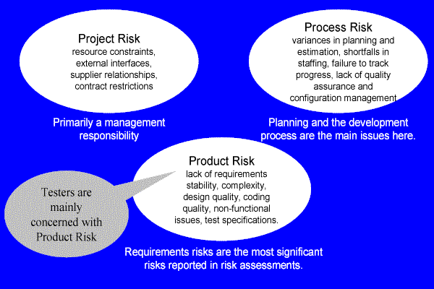
Three types of software risk

Slide 12
Product Risks
Potential failure areas (adverse future events or hazards) in the software or system are known as product risks, as they are a risk to the quality of the product, such
Error-prone software delivered.
The potential that the software/hardware could cause harm to an individual or company.
Poor software quality characteristics (e.g. functionality, security, reliability, usability and performance).
Software that does not perform its intended functions.

Slide 13
Process risks
Poor planning
under (or over) estimation
assignment of the wrongly skilled or under-skilled resources
Poor monitoring
failure to monitor progress against plans
failure to monitor the results of testing
Poor control
failure to understand the impact of events occurring
failure to take any action or the wrong actions when confronted by problems.

Slide 14
Risk-Based Testing
Risks are used to decide where to start testing and where to test more; testing is used to reduce the risk of an adverse effect occurring, or to reduce its impact.
Product risks are a special type of risk to the success of a project.
Testing as a risk-control activity provides feedback about the residual risk by measuring the effectiveness of critical defect removal and of contingency plans.

Slide 15
Risk-Based Testing 2
In a risk-based approach the risks identified may be used to:
Determine the test techniques to be employed.
Determine the extent of testing to be carried out.* Prioritize testing in an attempt to find the critical defects as early as possible.
Determine whether any non-testing activities could be employed to reduce risk (e.g. providing training to inexperienced designers).
Risk-based testing draws on the collective knowledge and insight of the project stakeholders to determine the risks and the levels of testing required to address

Slide 16
Risk-Based Testing 3
To ensure that the chance of a product failure is minimized, risk management activities provide a disciplined approach to:
Assess (and reassess on a regular basis) what can go wrong (risks).
Determine what risks are important to deal with.
Implement actions to deal with those risks.
In addition, testing may support the identification of new risks, may help to determine what risks should be reduced, and may lower uncertainty about risks.

Slide 17
Brainstorm: Identifying risks
For each of the key requirements, let’s make a list of the possible modes of failure
Main requirements of an ATM:
validation of a customers card and PIN - The machine should accept a valid card and validate your PIN number prior to you using the other features of the ATM.
cash withdrawal - The machine accepts a request for a cash withdrawal up to the limit on your card.
on-line balance request - The machine will display an up to date balance of your account.
request a statement to be sent to your address
...amongst others.

Slide 18
Risk for 4 main categories
Validation of a customer card and PIN
Cash withdrawal
On-line Balance Request
Request a Statement

Slide 19
Risk for 4 main categories
Validation of a customer card and PIN
Machine will not allow card to be inserted
Machine accepts an invalid card
Machine accepts card but locks up and wont return it
Machine accepts an invalid PIN and allows user to proceed
Machine rejects a valid PIN and retains card

Slide 20
Incident Management

Slide 21
Why track incidents?
The objectives of incident reporting:
To provide developers and other parties with feedback about the problem to enable identification, isolation and correction as necessary.
To provide test leaders a means of tracking the quality of the system under test and the progress of the testing.
To provide an input to test process improvement initiatives.

Slide 22
When to log an incident
We log incidents when a test result appears to be different from the expected result
This could be because:
something wrong with the test
something wrong with the expected result
something wrong with the tester
a misinterpretation of the result
something wrong with the test environment
something wrong with the baseline
Or it COULD BE a software fault.

Slide 23
Incident reporting
The tester should stop and complete an incident report
describe exactly what is "wrong"
document the test script and script step identifiers
attach any outputs (screen dumps or printouts) that may be useful
impact on your current tests

Slide 24

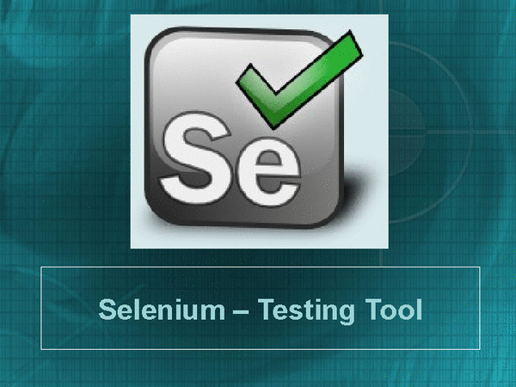
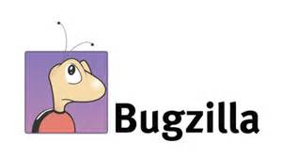
The Tooling Jungle – a very brief overview
Automated UT
IDE
Defect Tracking
Automated Web/GUI/ST
CI/Cdep/Cdel
General info
pyunit
junit
IDLE
Eclipse
Most commonly used IDEs?
Most commonly used tools?
15 Most common defect tracking tools?
Top 8 tools?
Note: Some tools do more than just one thing (e.g. defect tracking tools may also be used for project management).
Useful link: http://www.testingtools.com/test-automation/

Slide 25
Links to interesting & relevant tooling support
One view on what the most commonly used IDEs are:
https://www.g2crowd.com/categories/integrated-development-environment-ide
One view on what the 15 most common defect tracking tools are:
http://www.softwaretestinghelp.com/popular-bug-tracking-software/
Selenium automated web testing:
http://docs.seleniumhq.org/
General info on continuous integration, continuous deployment, and continuous delivery:
https://codeship.com/continuous-integration-essentials
One view on the most commonly used CI tools:
https://www.g2crowd.com/categories/continuous-integration
Another view on the top 8 SI tools:
https://dzone.com/articles/top-8-continuous-integration-tools

Slide 26
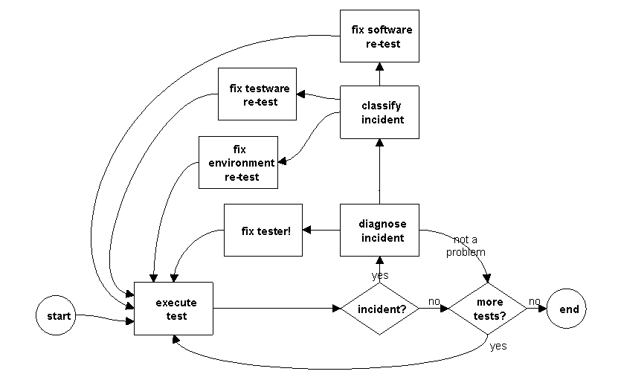
Typical test execution and incident management process

Slide 27
Incident reporting
Bug tracking software:
Reporting facility – complete with fields that will let you provide information about the bug, environment, module, severity, screenshots etc.
Assigning – What good is a bug when all you can do is find it and keep it to yourself, right?
Progressing through the life cycle stages – Workflow
History/work log/comments
Reports – graphs or charts
Storage and retrieval – Every entity in a testing process needs to be uniquely identifiable, the same rule applies to bugs too. So, a bug tracking tool must provide a way to have an ID, which can be used to store, retrieve (search) and organize bug information.

